Slide 1

Ansible
About Ansible
Installation
Configuring Ansible
Ansible Concepts
ad-hoc Commands

Slide 2
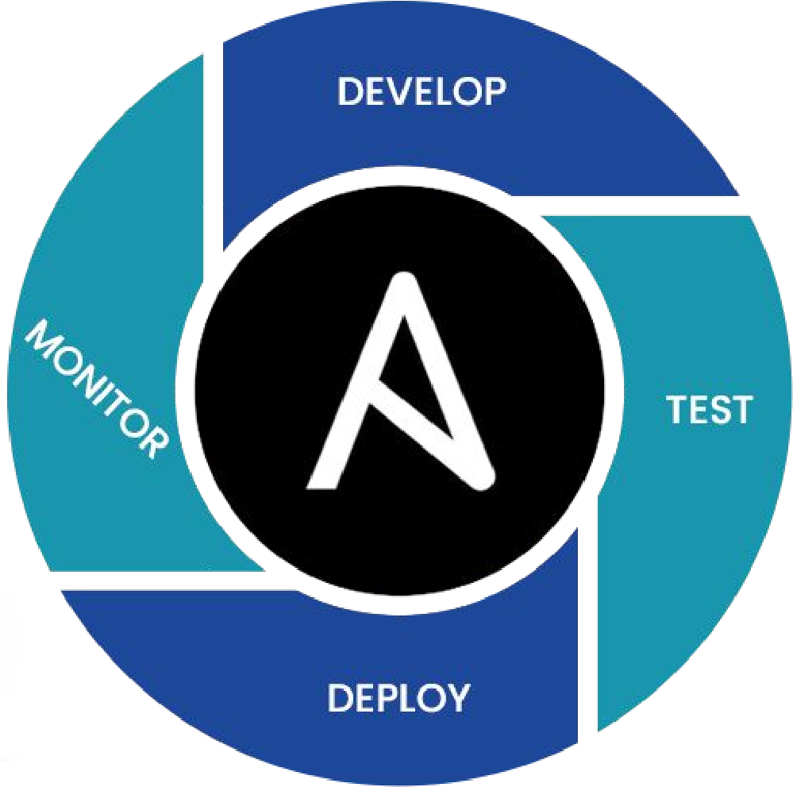
About Ansible
Ansible is an open-source IT automation tool.
It can configure systems, deploy software, and orchestrate more advanced IT tasks such as continuous deployments

Slide 3
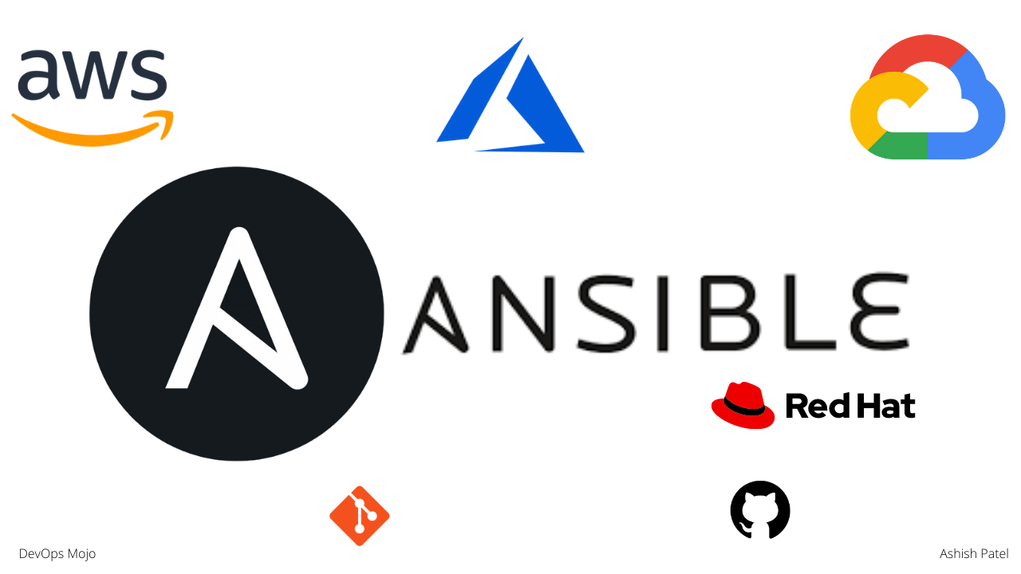
Configuration Management Tools
Ansible, Chef, Puppet, Salt
Agent (less)
Languages, YAML, Python, Perl
Easy to use, human readible

Slide 4
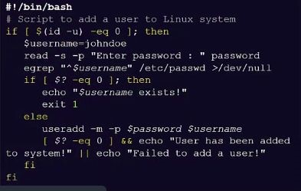
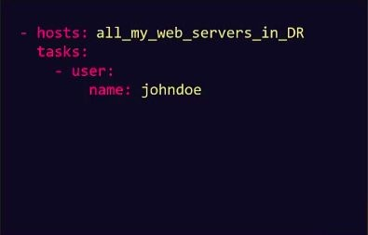
Scripts Playbook

Slide 5
Benefits
SIMPLE POWERFULL AGENTLESS
Human readable automation ● App deployment ● Agentless architecture
No special codding skills needed ● Configuration management ● Uses Open SSH
Tasks executed in order ● Workflow orchestration ● No agents to exploit or update
Get productive quickly Orchestrate the app lifecycle More efficient & more secure

Slide 6
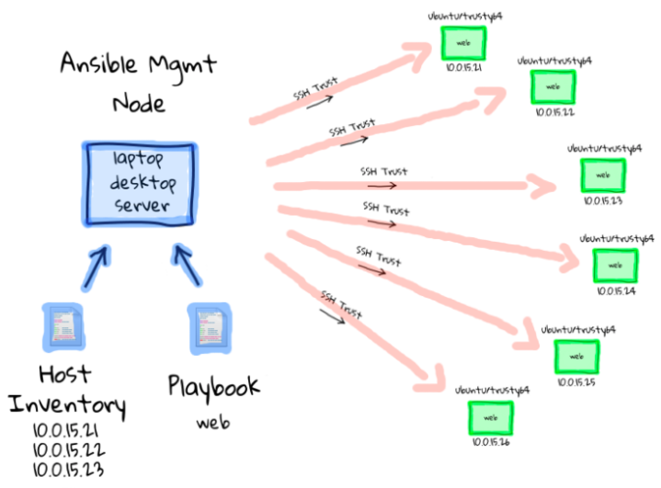
How It Works
● Declarative
● Agentless
● Idempotent
● Community
● Provisioning
● Configuration Management
● Application Deployment

Slide 7

Installation
We can install Ansible using yum and apt package managers.
For install with yum:
sudo yum -y install ansible
For install with apt:
sudo apt-get -y install ansible

Slide 8
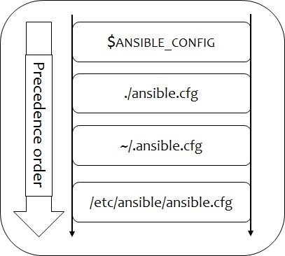
Configuring Ansible
Ansible supports several sources for configuring its behavior, including a file named ansible.cfg, environment variables, command-line options, playbook keywords, and variables.
Certain settings in Ansible are adjustable via a configuration file (ansible.cfg).
Changes can be made and used in a configuration file which will be searched for in the following order:

Slide 9
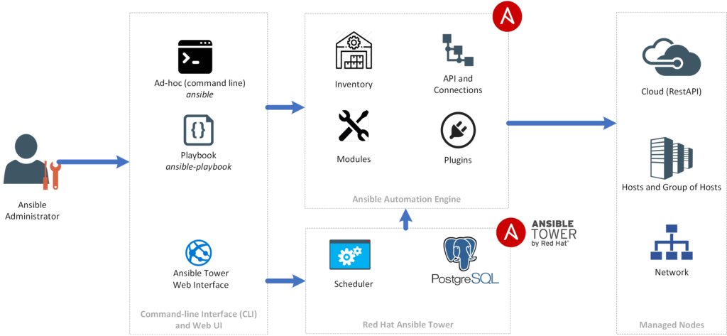
Ansible Concepts
Control Node
Managed Nodes
Inventory
Playbooks
Tasks
Modules
Ad-hoc Commands

Slide 10
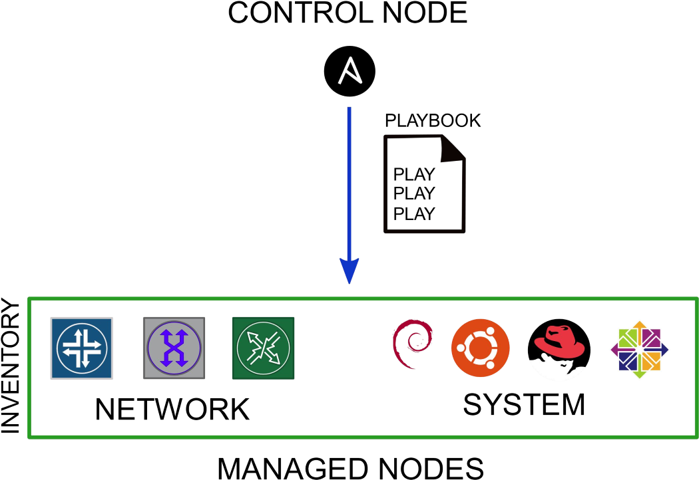
Control Node:
Any machine with Ansible installed. You can run commands and playbooks, invoking
/usr/bin/ansible or /usr/bin/ansible-playbook, from any control node. You can use any computer that has Python installed on it as a control node - laptops, shared desktops, and servers can all run Ansible. However, you cannot use a Windows machine as a control node.

Slide 11
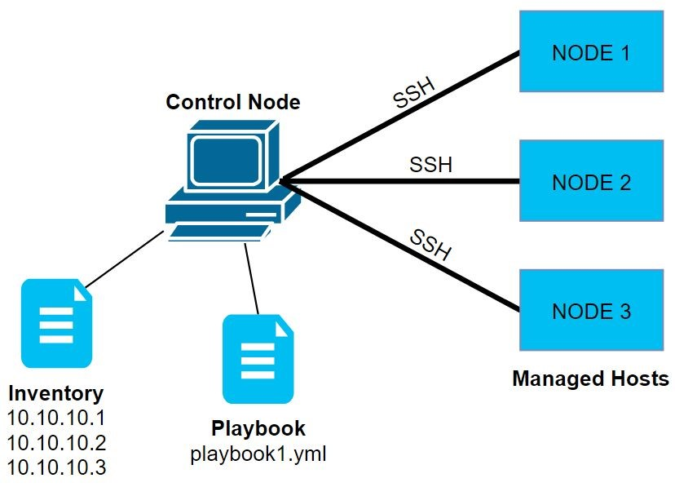
Managed Nodes:
The network devices (and/or servers) you manage with Ansible. Managed nodes are also sometimes called hosts. Ansible is not installed on managed nodes. They just need to be accessible through SSH connection.

Slide 12
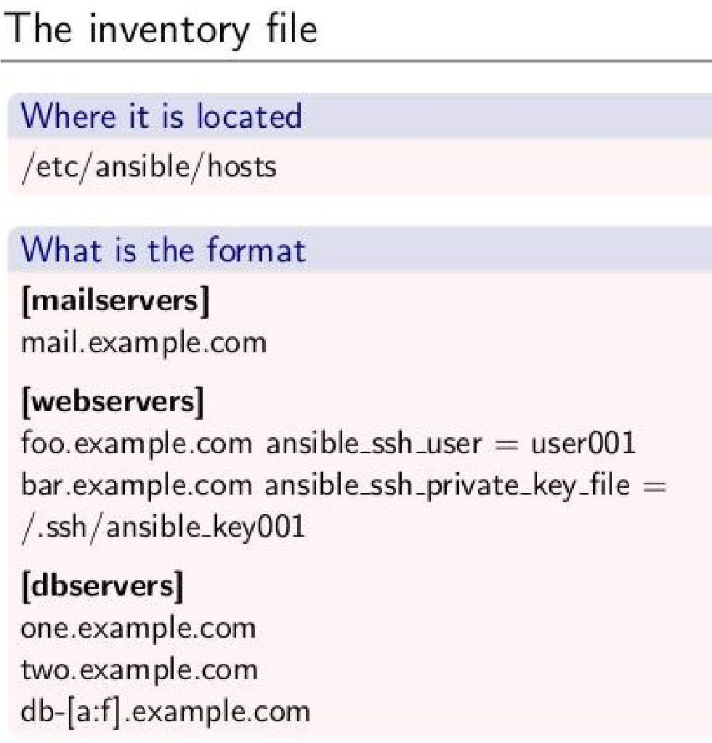
Inventory:
A list of managed nodes. An inventory file is also sometimes called a hostfile. Your inventory can specify information like IP address for each managed node. An inventory can also organize managed nodes, creating and nesting groups for easier scaling.
Usually creatd as static, but can be dynamic

Slide 13
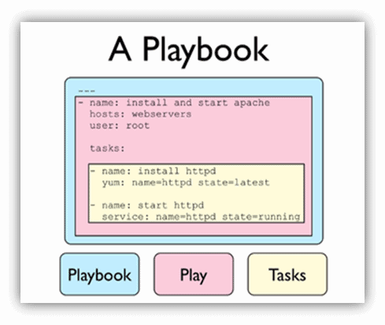
Playbooks:
Ordered lists of tasks, saved so you can run those tasks in that order repeatedly. Playbooks can include variables as well as tasks. Playbooks are written in YAML and are easy to read, write, share and understand.

Slide 14
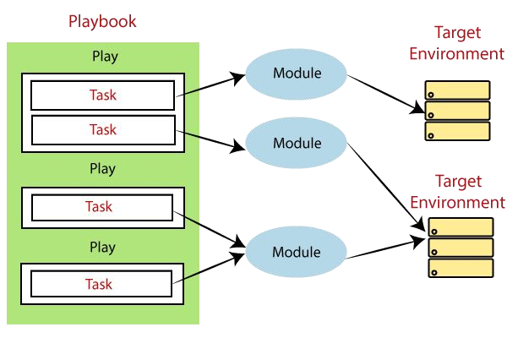
Tasks:
The units of action in Ansible. You can execute a single task once with an ad-hoc command.
Each action to perform is defined as a task.
Ad-hoc & playbook

Slide 15
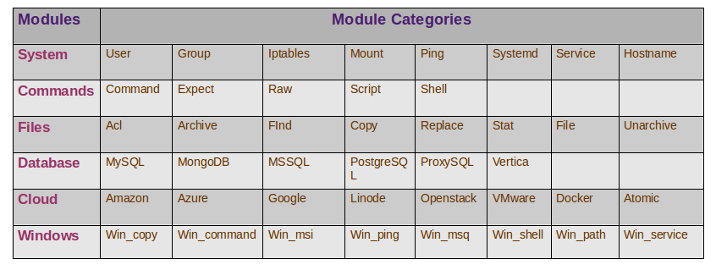
Modules:
The units of code Ansible executes. Each module has a particular use, from administering users on a specific type of database to managing VLAN interfaces on a specific type of network device.

Slide 16
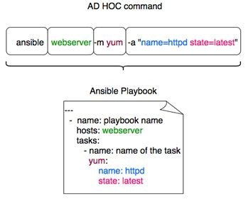
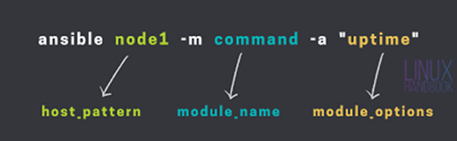
Ad-hoc Commands:
An Ansible ad-hoc command uses the /usr/bin/ansible command-line tool to automate a single task on one or more managed nodes.
Ad-hoc commands are quick and easy, but they are not reusable.
•Ad-hoc commands demonstrate the simplicity and power of Ansible.
•Ad-hoc commands are great for tasks you repeat rarely

